Slide 1
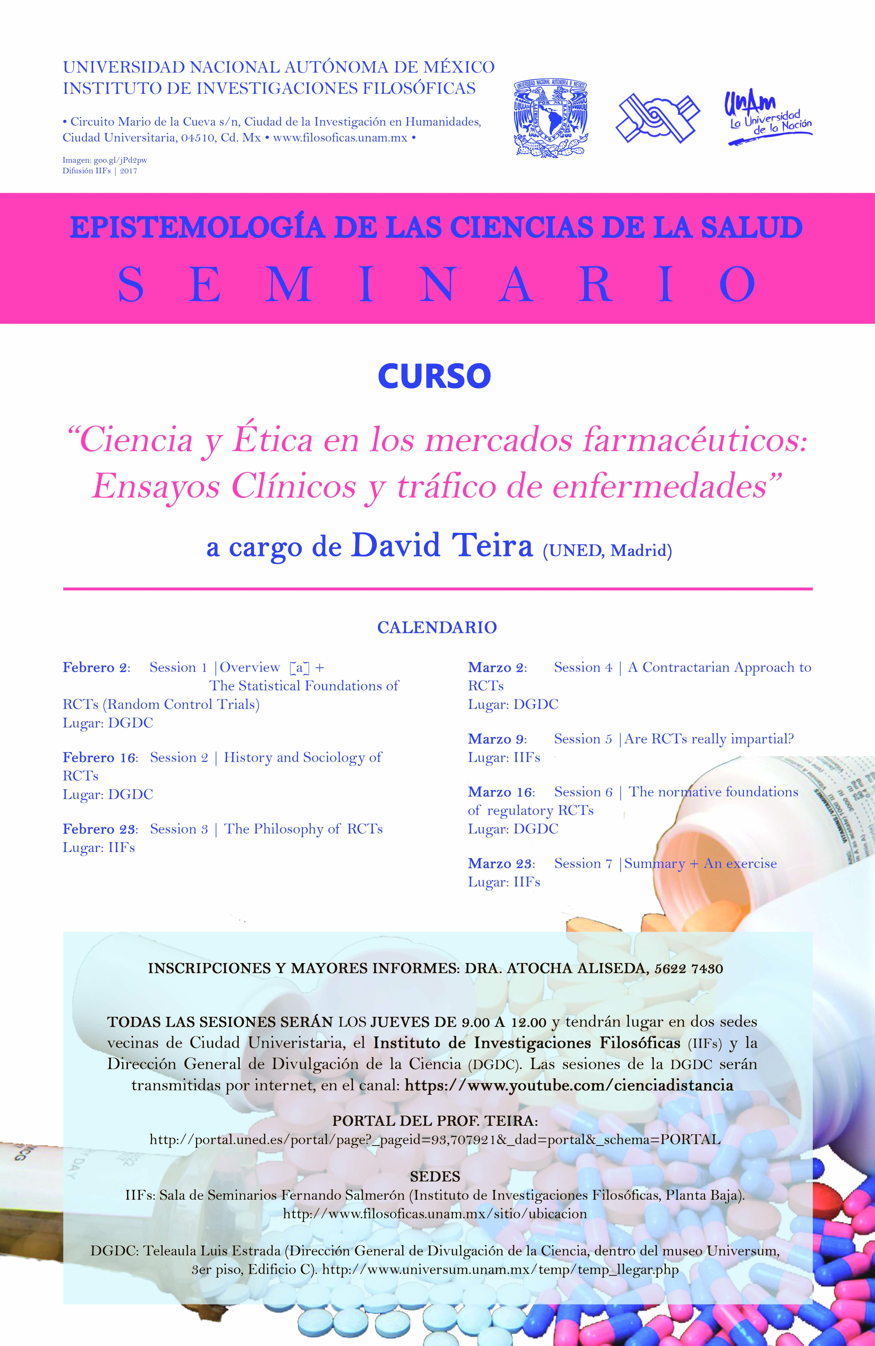

Slide 2
  Plan del curso
  Sesión 1
  ¿Qué son los ensayos clínicos?
  Fundamentos probabilísticos
  Sesión 2
  Historia y sociología: conflictos de intereses

Slide 3
  Plan del curso
  Sesión 3
  Filosofía de la ciencia: Causalidad y verdad
  Sesión 4: Imparcialidad
  Epistemología social: el contractualismo

Slide 4
  Plan del curso
  Sesión 5
  ¿Son los ensayos clínicos realmente imparciales?
    Los límites de la imparcialidad son los de la metodología
  Sesión 6
  Los fundamentos normativos de los ensayos clínicos regulatorios

Slide 5
1 | Tráfico de enfermedades y ensayos clínicos
    Los límites de la imparcialidad son los de la metodología
  Tráfico de enfermedades (disease-mongering)
  Dos versiones: Fuerte y débil
  No hay corrección puramente metodológica
  Dos ejemplos: Benzodiazepinas & Estatinas
Notes:
The goal of this talk is quite simple: i want to provide a precise definition of disease mongering, showing how the pharmaceutical industry can exploit two statisticall pitfalls in clinical trials for marketing purposes.
In the first part of this talk, I’ll present my argument and, if I had time, I’d illustrate it with two case studies, closing with some concluding remarks

Slide 6
2 | Fundamentos normativos
  1. La justificación de la regulación farmacéutica
    Argumento liberal
    Argumento paternalista
  2. Un fundamento alternativo para el paternalismo
    La objeción socialista
    La objeción liberal
Notes:
Why would a liberal want pharmaceutical regulation? Broadly speaking, liberals want markets and drug markets may crumble if unsupervised: consumers cannot tell on their own whether a drug is good by how it looks or how it works on them. Hence drugs are easy to fake and in markets with fake drugs, nobody invests in producing good treatments, it’s just too expensive. That’s what economists call adverse selection

Slide 7
Tráfico de enfermedades, en sentido amplio
  Una supuesta estrategia comercial de la industria farmacéutica para manipular la definición de una enfermedad y así promocionar las ventas de sus productos
    British Medical Journal (2002)
    Plos Medicine (2006)
Notes:
Broadly speaking, disease-mongering would be a commercial strategy of the Big Pharma: the industry would tinker with the definition of certain conditions in order to boost sales for their purported remedies. Although not everybody accepts its existence, the phenomenon has received attention in major medical journals

Slide 8
Conceptos cercanos
  1970s: la medicalización como régimen disciplinario
  [M. Foucault, I. Illich]
    A. Murguía, T. Ordorika, F. Guerrero, “Consideraciones epistemológicas en torno a la medicalización en América Latina”, Ludus vitalis 2016
  2000s: la farmaceuticalización como estrategia capitalista
  [J. Abraham, T. Moreira, A. Petryna, ]
Notes:
Even more broadly speaking, disease-mongering can be connected with topics such as the medicalization of society, an idea advocated in the 1970s by MF or IV according to which societies control deviant behavior transforming it into a disease. More recently, sociologists such as John Abraham or Adriana Petryna have denounced the transformation of health into a global market in which the interests of the patients are not driving anymore the industry

Slide 9
Tráfico de enfermedades, en sentido amplio
¿Cuan grande es el poder de la publicidad farmacéutica?
  Sí? Transformar una colección de síntomas médicos menores en una enfermedad tratable
  [Eg., la disfunción sexual femenina (Lexchin 2006)]
  Sí: Desde los años 1980, los responsables de marketing presiden el proceso de desarrollo de medicamentos en la industria farmacéutica.
  [Eg, Glaxo (Lynn 1993)]
Notes:
I don’t know whether medicalization or pharmaceuticalization are real threats, but it is a fact that the power of advertising in health markets is big. At least from the 1980s we know for certain that advertising executives intervene in the drug development process right from the beginning, deciding which conditions are more promising and how many resources should be allocated to investigate therapies, and so on and so forth. It is more open to discussion whether the marketing power of the Big Pharma is as big as to transform fuzzy collections of symptoms into treatable diseases. I will remain agnostic regarding this sort of disease mongering

Slide 10
Tráfico de enfermedades, en sentido estrecho
Tesis
  La publicidad farmacéutica puede explotar comercialmente una enfermedad cuando su mejor definición proviene del éxito de un tratamiento en un ensayo clínico
  ¿Cómo?
  Dos formas de manipular la definición de la población del ensayo: fuerte & débil
Notes:
I am going to defend that there are certain conditions that can be exploited for marketing purposes. These are conditions that are operationally defined in terms of a succesful therapy: if we can cure it, it’s real. And we know we can cure it if the treatment succeeds in a clinical trial. We can commercially exploit such trial tinkering with the definition of the population of patients it targets. I am going to defend that this can happen two ways.

Slide 11
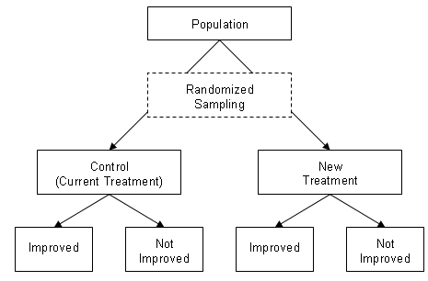
Tráfico de enfermedades, en sentido estrecho
Notes:
Before developing my claims, let me recall some basic facts about a clinical trial: generally speaking, this is an experimental design in which we compare the effects of two treatments on two groups of patients. We allocate the treatments at random, we measure the effects in both groups and then we assess the difference between them if there is any

Slide 12
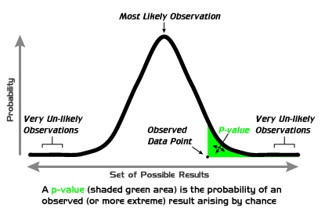
Tráfico de enfermedades, en sentido estrecho
  H₀ : no hay diferencia entre tratamientos
Notes:
Clinical trials are designed and interpreted assuming a frequentist interpretation of probabilities: if we observe a difference between the effects of the two treatments, we can assess its significance calculating how often would we see such difference if we repeated the experiment time and again. This is the p-value

Slide 13
Tráfico de enfermedades, en sentido estrecho
  En un ensayo frecuentista las probabilidades son indisociables del diseño experimental
  └ Nuestra evidencia es válida sólo para la población del ensayo
    Fuera de esta clase de referencia, el ensayo no nos permite extrapolar sus conclusiones con garantías probabilísticas.
Notes:
P-values are therefore tied to a given experimental design: we are not calculating the probability that a treatment is effective unconditionally, but rather the probability of seeing a given difference between treatments if we replicated the trial. One crucial feature of the trial is the definition of the population it targets, the group of patients that might benefit from the treatment. These are defined in terms of a set of elligibility criteria, establishing who can take part in the test. Beyond these criteria, the trial provides no clue as to the effects of the treatments in other types of patients.

Slide 14
Tráfico de enfermedades, en sentido estrecho
  Los criterios de selección de pacientes:
  Consideraciones biológicas → homogeneidad
  Consideraciones clínicas→ heterogeneidad
  └ El TE ocurre cuando predominan estas últimas: una enfermedad existe si podamos curarla, aunque no sepamos bien cómo
Notes:
The disease as it appears in the lab; the disease as it appears to the doctor.

Slide 15
  Desde los años 1950, los ensayos clínicos nos han proporcionado una definición operativa de enfermedad:
    Identificamos una enfermedad si somos capaces de curarla en un ensayo clínico aplicando un tratamiento sobre un grupo de pacientes
      → El mecanismo causal subyacente puede sernos desconocido
      → El ensayo nos permite evaluar la seguridad y eficacia del tratamiento
Notes:
Now you may wonder how this population tinkering impinges on our definition of disease. My anwers is that from the 1950s onwards RCTs have provided a working definition of disease: from a clinical perspective, we have an operational definition of disease if we can cure it. It has often happened in medicine that the causal mechanisms by which a drug yielded a cure were not properly undestood. Yet clinical trials allowed us to hedge this uncertainty showing a range of circumstances under which the treatment was safe and effective

Slide 16
Tráfico de enfermedades, en sentido estrecho
  ¿Cómo explotar comercialmente la población de un ensayo?
  Necesitamos un medicamento que funcione sobre una población dada para obtener la aprobación del regulador (acceso al mercado).
  Cuanto mayor la población, mayores serán las ventas
Notes:
From a commercial perspective, the trial population is interesting on at least two accounts: we need first a group of patients on which a therapy works in order to get market access. Ideally the industry would want this group to be as big as possible in order to maximize sales once we got there.

Slide 17
  Dos formas de explotar las enfermedades definidas a través del éxito en un ensayo clínico
  Débil
    Promocionar la prescripción de un medicamento, una vez aprobado, para usos sobre poblaciones no estudiadas en el ensayo
    → “Débil”: no afecta al propio ensayo
Notes:
I contend, now, that the industry can tinker with the definition of the trial population for marketing purposes in two ways. Mild disease mongering occurs when pharmaceutical advertising promotes the prescription of a treatment beyond the population on which it was originally tested, misleading physicians to believe that anyone can benefit from it. I call this mild DM because we tinker with the definition of the population after the trial

Slide 18
  Dos formas de explotar las enfermedades definidas a través del éxito en un ensayo clínico
  Fuerte
    Buscar el mayor grupo de pacientes donde se pueda encontrar una diferencia estadísticamente significativa entre tratamientos (con independencia de consideraciones clínicas)
Notes:
I contend, now, that the industry can tinker with the definition of the trial population for marketing purposes in two ways. Mild disease mongering occurs when pharmaceutical advertising promotes the prescription of a treatment beyond the population on which it was originally tested, misleading physicians to believe that anyone can benefit from it. I call this mild DM because we tinker with the definition of the population after the trial

Slide 19
La estadística, por sí sóla, no nos permitirá corregirlo
  TE débil [off-label prescription]
    → Significación estadística vs. significación clínica
      Encontrar un grupo de pacientes sobre los que un tratamiento pueda lograr un resultado estadísticamente positivo en un ensayo no nos garantiza su relevancia clínica
Notes:
However, this statistical definition of disease cannot be complete since there are two methodological dilemmas that require an extra-statistical solution. Underlying mild disease-mongering we find the reference class problem: depending on how a physician diagnoses a patient, the probability that he benefits from a treatment will be one or another. Is he similar enough to the patients treated in the trial to benefit from a treatment just like they did?

Slide 20
La estadística, por sí sóla, no nos permitirá corregirlo
  TE fuerte
    → El problema de la clase de referencia
      No hay un método estadístico para identificar a qué clase de referencia pertenece un paciente concreto
Notes:
However, this statistical definition of disease cannot be complete since there are two methodological dilemmas that require an extra-statistical solution. Underlying mild disease-mongering we find the reference class problem: depending on how a physician diagnoses a patient, the probability that he benefits from a treatment will be one or another. Is he similar enough to the patients treated in the trial to benefit from a treatment just like they did?

Slide 21
Sinopsis
  Tráfico de enfermedades en sentido estrecho
  Cuando la definición de una enfermedad se basa en un tratamiento que tiene éxito en un ensayo, se puede manipular la definición de la población del ensayo con propósitos comerciales
    a) Débil: Prescribirlo a una población diferente
    b) Fuerte: Buscar resultados estadísticamente positivos en un grupo de pacientes con independencia de su significación clínica
Notes:
Recapitulating what i’ve said so far, I propose the following definition of DM [*] DM happens two ways:

Slide 22
Los límites de la imparcialidad son los límites de la metodología
  No hay una solución puramente estadística
    a) TE Débil: el problema de la clase de referencia
    b) TE Fuerte: significación estadística no implica significación clínica
Notes:
I contend that there is no purely statistical correction for DM, since there is no statistical solution for the two methodological dilemmas on which DM hinges. Of course, at the end of my talk I will advocate some extra-statistical alternatives. But before I get there, let me now illustrate both types of DM with a couple of short case-studies

Slide 23
Dos ejemplos
  TE Débil: benzodiacepinas
    Enfermedad: Ansiedad
    Población: del manicomio al uso doméstico
  TE Fuete: estatinas
    Enfermedad: hipercolesterolemia
    Población: los niveles de colesterol como diana móvil
Notes:
I will illustrate mild-disease mongering with the marketing of Valium, a tranquilizer targeting anxiety that was tested on very restrictive groups of people and then promoted as a catch-all drug for the general population.
As for strong DM, I will illustrate it with the treatment of hypercholesterolemia with statins, targetting bigger and bigger groups of patients in trials

Slide 24
TE débil: Librium & Valium
  Desarrollo de medicamentos y lotería molecular (-1970s)
    1)Estudio de la actividad biológica de un compuesto en el laboratorio
    2) Incertidumbre sobre sus efectos en organismos humanos: mecanismos desconocidos
    → Ensayo y error en los ensayos clínicos
Notes:
DM mongering targets conditions that are operationally defined through a succesful treatment in a trial. If we can cure it, we can define it. This is less odd than it may initially sound if you think that for more than thirty years, the pharmaceutical industry approached drug development as a sort of molecular lottery. You explored compounds in the lab for signs of therapeutic activity and if you catched some, you sent it to test on animals and, eventuallly, on humans. The causal understanding of both the disease and the drug was often poor and, under such circumstances, RCTs guided drug development through literally trial and error.

Slide 25
TE débil: Librium & Valium
  Benzodiacepinas [Leo Sternbach | Roche]
  1957: Librium → 1958: RCT → 1960: FDA
  1958: Valium → 1959: RCT → 1963: FDA
  1972: Roche, la compañía más cotizada
  1977: se descubre el mecanismo biológico
Notes:
This was certainly the case of Valium. In the 1950s there was an emerging market for tranquilizers and Leo Sternbach a chemist at Roche was commisioned to find one. He started investigating a family of molecules with potential biological activity and just by chance he found one that had sedative properties on animals. This was Librium, the first benzodiazepine. It was tested in 1958 and in 1960 the FDA approved its commercial distribution. Valium was the second hit in the series but its commercial success was so big, that it made Roche the Apple of the 1970s. Yet, despite the big success of the benzodiazepines their biological mechanism was only understood in 1977

Slide 26
TE débil: Librium & Valium
    “Throughout most of this era, the therapeutic use of psychotropes did not depend on any particular theory about why they worked” (D. Herzberg)
    → Su prescripción dependía de los ensayos clínicos
      Efecto tranquilizador sobre la ansiedad en pacientes psiquiátricos
      [no uniforme, no claramente superior al placebo/barbitúricos]
Notes:
In this respect, itw as not unusal, most tranquilizers operated in the blind and the only standard of efficacy was their success in a trial. Valium showed some efficacy in the symptomatic treatment of anxiety in serious psychiatric conditions. Beyond these latter, its effect was neither uniform nor superior to alternative treatments

Slide 27
TE débil: Librium & Valium
  La perspectiva del marketing : there was “almost nothing you couldn’t use it for”
    → Era necesaria una receta médica
      Roche inaugura una nueva era en la publicida farmacéutica, anunciándolo directamente a médicos como tratamiento para toda clase de ansiedades
Notes:
Roche advertising executives realized that there was nothing you couldn’t use it for, since anxiety was everywhere. Howeve, it was a prescription drug, you needed a doctor recommending it, so Roche inaugurated an era of direct advertising to physicians selling them the drug as if its efficacy had been proven well beyond the original target population in the trial

Slide 28
TE débil: Librium & Valium
  El problema de la clase de referencia
    Los médicos debían decidir si cada paciente que se les presentaba en la consulta era un miembro de la población definida en el ensayo.
  La trampa:
    La dificultad de definir la ansiedad con independencia de una colección de síntomas que el Valium podía aliviar
Notes:
Behind this advertisign strategy we find the reference class problem: how does a physician know if a particular patient is similar enough to those treated in the trials? The problem was, of course, the definition of anxiety, a badly understood collection of symptoms that, for all practical purposes, was defined through therapeutic success. Someone had anxiety if Valium was effective in relieving it.

Slide 29
TE débil: Librium & Valium
  TE Débil
  La ansiedad se definía operativamente como una colección de síntomas aliviados por el Valium en un ensayo clínico
  Las fronteras de esta población eran suficientemente difusas como para prestarse a ampliaciones publicitarias
  En última instancia, el médico prescribiría el Valium si los síntomas del paciente eran “parecidos”.
Notes:
And this is, in my view, mild disease mongering: you have a condition that you don’t understand well, but you can succesfully treat it in a trial. However, the population you are targetting is defined in such a way that it can be expanded with an adequate market intervention. The physician should solve the reference class problem in prescribing it to individual patients. How good is the physician at solving this under so much pharmaceutical pressure?

Slide 30
TE débil: Librium & Valium
  ¿Cómo acabo todo?
  Éxito comercial entre las amas de casa de clase media
  Adictivo
  No hubo sanciones para Roche: la prescripción era responsabilidad del médico
Notes:
This is actually what happened with Valium: it was a great commercial success with middle-class housewives, but it happened to cause addiction. There was a huge scandal but nobody could accuse physicians of incorrect prescription, since nobody had a better definition of anxiety.

Slide 31
TE fuente: las estatinas
  Una enfermedad definida por un tratamiento exitoso
    Factor de riesgo: una variable fisiológica que permite predecir una enfermedad
    El factor de riesgo: el colesterol alto
    Enfermedad: stroke
    → ¿Por qué no tratar los factores de riesgo como enfermedad crónica?
      Idea original: 1960s
      Primer tratamiento exitoso: 1987
Notes:
As for strong disease-mongering, I will exemplify it with the treatment of hypercholesterolemia. Initially this was not a condition, but a risk factor: in epidemiological studies high blood cholesterol seemed to be a good predictor of strokes. So in the 1960s someone came up with the idea of controlling hypercholesterolemia in order to prevent strokes. It became very popular, but it was only materialized in a succesful treatment in 1987

Slide 32
TE fuente: las estatinas
  La diana móvil:
    Los niveles “normales” de colesterol
    → Sin un tratamiento que supere un ensayo clínico, ¿cómo definir la hipercolesterolemia como una patología?
    → Hard/Soft endpoints: ¿cuándo acaba el ensayo clínico?
Notes:
The problem in defining hypercholesterolemia is to establish the normal levels of cholesterol. The assumption is that abnormal levels may cause stroke, but if you can’t prove that lowering cholesterol prevents it, how can you claim that hypercholesterolemia is a disease?

Slide 33
TE fuente: las estatinas
  Mevacor (Merck)
  1985: ensayo exitoso contra la hipercolesterolomeia genética severa
  1986: ensayo exitoso con pacientes con colesterol 240mg/dL
  1988 : 200mg/dL
  1994: 130mg/dL [Zocor (Merck)]
  1995: 130mg/dL [Pravacol (Bristol-Myers)]
Notes:
The discovery of statins transformed cholesterol into a moving target: in 1985 it was proven in a trial that it can reduce genetic severe hypercholesterolemia. A year later a second trial showed it worked as well with patients which had over 240mg per DL. In 1988 Mevacor was shown to work as well with patients with levels above 200mg/dL. In the coming decade Zocor and Pravacor showed that they could lower your levels of cholesterol belo 130 mg/dL in completely healthy patients.

Slide 34
TE fuente: las estatinas
  En tres décadas, los niveles saludables de colesterol se redujeron unos 95mg/dL
  Implicaciones comerciales :
    “The 2001 guidelines nearly tripled the proportion of the U.S. population that was eligible for lipid-lowering therapy to a market of 36 million people” (J. Greene)
    → La mayor parte de los expertos que decidían sobre los niveles normales del colesterol tenían lazos con la industria
Notes:
All in all, healthy levels of cholesterol were cut to less than a halve in 30 years. The marketing implications of this reduction were huge: suddenly there was a market of millions of potential patients treatable with statins. Needless to say, the experts deciding about the normal levels of cholesterol had ties with the industry, almost all of them

Slide 35
TE fuente: las estatinas
  El dilema metodológico :
  → Significación estadística/clínica
    Que un medicamento pueda reducir tu nivel de colesterol no implica que se deba reducir
Notes:
The problem that these experts had to face is how to interpret the reduction of cholesterol levels. It was a statistically significant event, but its clinical interpretation is open to discussion, and I am citing here no less than Ben Goldacre to illustrate it

Slide 36
Trials have been done comparing a statin against placebo, and these have shown that they save lives rather well. Trials have also compared one statin with another: but these all use cholesterol as a surrogate outcome. Nobody has ever compared the statins against each other to measure which is best at preventing death. This is a truly staggering oversight, when you consider that tens of millions of people around the world have taken these drugs, and for many, many years. If just one of them is only 2 per cent better at preventing heart attacks than the others, we are permitting a vast number of avoidable deaths, every day of the week. (Goldacre 2012, 148)

Slide 37
En resumen
  El TE a través de ensayos clínicos
  Una enfermedad se define por un tratamiento exitoso
  La población se amplía con propósitos comerciales: débil (tras el ensayo) y fuerte (en ensayos sucesivos)
  Dilema metodológico: el problema de la clase de referencia (TE débil) & significación estadística/clínica (TE fuerte)
Notes:
These were my two illustrations. Summing up my narrow definition of disease-mongering it goes as follows: it happens with conditions that are implicitly defined through success in a trial and the marketing intervention consists in expanding the population of patients considered in the trial. There is no purely statistical correction for Disease-mongering since its two varieties hinge on deeply entrenched methodological problems

Slide 38
¿Qué hacer?
    Enfermedades mejor definidas
    Ensayos clínicos más precisos:
      Variables de resultado clínicamente significativas
      Población semejante al usuario final
  ∟ ¿A quién sirven nuestros experimentos?
Notes:
Of course, we would need expert judgment to solve these problems: but how can we protect the experts from the influence of marketing? On the one hand we would need stronger definitions of disease for more conditions, but we still don’t have them for many. Lacking them, we can conduct stronger trials with clinically significant endpoints (such as death instead of cholesterol reduction in the case of statins) and we should mandarte that the target groups of patients are as similar as possible to then enduser. We could go on on how to organize trials to achieve it. But I’ll leave it here, with my congratulations to nancy for her birthday

Slide 39
2 | Fundamentos normativos
  1. La justificación de la regulación farmacéutica
    Argumento liberal
    Argumento paternalista
  2. Un fundamento alternativo para el paternalismo
    La objeción socialista
    La objeción liberal
Notes:
Why would a liberal want pharmaceutical regulation? Broadly speaking, liberals want markets and drug markets may crumble if unsupervised: consumers cannot tell on their own whether a drug is good by how it looks or how it works on them. Hence drugs are easy to fake and in markets with fake drugs, nobody invests in producing good treatments, it’s just too expensive. That’s what economists call adverse selection

Slide 40
(a) El argumento liberal: fallos de mercado
└ ¿Por qué necesitamos un regulador?
  A simple vista, no diferenciamos un medicamento bueno de uno malo
  Hay una tasa natural de variabilidad en sus efectos
  En estas condiciones, el mercado sufrirá selección adversa
Notes:
Why would a liberal want pharmaceutical regulation? Broadly speaking, liberals want markets and drug markets may crumble if unsupervised: consumers cannot tell on their own whether a drug is good by how it looks or how it works on them. Hence drugs are easy to fake and in markets with fake drugs, nobody invests in producing good treatments, it’s just too expensive. That’s what economists call adverse selection

Slide 41
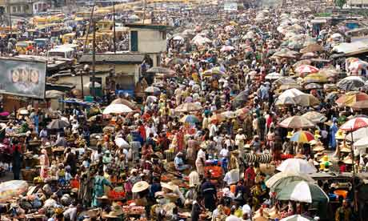
(a) El argumento liberal: fallos de mercado
Selección adversa
  1930s: La Association of British Chemical Manufacturers solicita que el Gobierno realice controles de calidad.
  2010s: Encuentre un medicamento en Nigeria
  [Kristin Peterson (2014), Speculative markets]
Notes:
Historically, we have often seen adverse selection. It’s remarkable how in the 1930s the British pharmaceutical industry was requesting the intervention of the Administration in order to drive out of the market a growing number of rogue competitors. And you see it today in Nigeria, according to Kristin Peterson, because it is simply impossible to regulate pharmaceutical marketplaces as the one you see on the screen.

Slide 42
(a) El argumento liberal: fallos de mercado
La respuesta regulatoria:
  The US Food and Drug Administration (FDA)
  1906: Composición: es lo que dice ser
  1938: Seguridad: no te va a envenenar
Notes:
Historically, we have often seen adverse selection. It’s remarkable how in the 1930s the British pharmaceutical industry was requesting the intervention of the Administration in order to drive out of the market a growing number of rogue competitors. And you see it today in Nigeria, according to Kristin Peterson, because it is simply impossible to regulate pharmaceutical marketplaces as the one you see on the screen.

Slide 43
(a) El argumento liberal
  └ Si queremos que la producción y distribución de medicamentos se produzca en un mercado, necesitamos evitar la selección adversa.
  Por tanto, regulemos.
Notes:
Historically, we have often seen adverse selection. It’s remarkable how in the 1930s the British pharmaceutical industry was requesting the intervention of the Administration in order to drive out of the market a growing number of rogue competitors. And you see it today in Nigeria, according to Kristin Peterson, because it is simply impossible to regulate pharmaceutical marketplaces as the one you see on the screen.

Slide 44
(b) El argumento paternalista
  └ Más allá de la regulación liberal:
  Aunque (i) un paciente quiera tomar un medicamento, (ii) esté advertido de sus riesgos y (iii) un médico esté dispuesto a prescribírselo, no podrá comprarlo legalmente a menos que el Estado lo autorice.
  E.g., una fórmula magistral
Notes:
Historically, we have often seen adverse selection. It’s remarkable how in the 1930s the British pharmaceutical industry was requesting the intervention of the Administration in order to drive out of the market a growing number of rogue competitors. And you see it today in Nigeria, according to Kristin Peterson, because it is simply impossible to regulate pharmaceutical marketplaces as the one you see on the screen.

Slide 45
(b) El argumento paternalista
  FDA 1962 Act: seguridad & eficacia
    Son necesarios (pero no suficientes) dos ensayos clínicos positivos para que la FDA apruebe un medicamento
Notes:
Historically, we have often seen adverse selection. It’s remarkable how in the 1930s the British pharmaceutical industry was requesting the intervention of the Administration in order to drive out of the market a growing number of rogue competitors. And you see it today in Nigeria, according to Kristin Peterson, because it is simply impossible to regulate pharmaceutical marketplaces as the one you see on the screen.

Slide 46
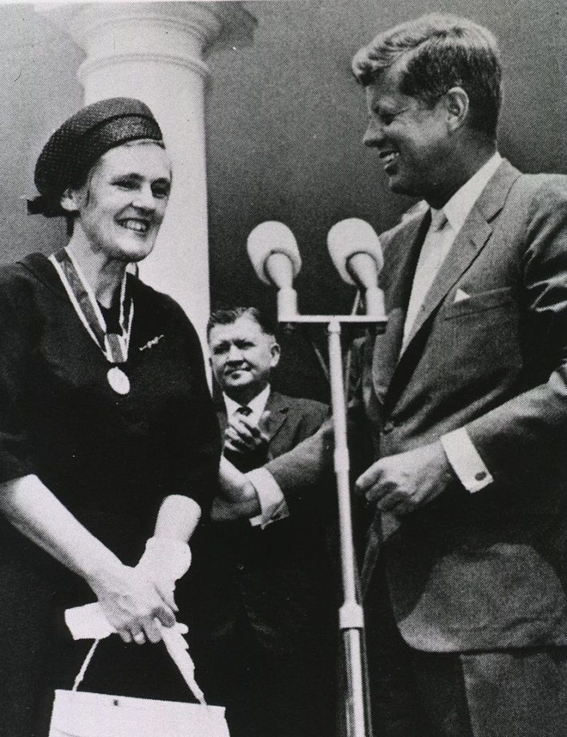
(b) El argumento paternalista
  La tragedia de la Talidomida:
Notes:
And indeed the major driver behind regulatory paternalism seems to be the consumers’ demand for higher levels of drug safety, as it happened in the 1960s with the Thalidomide scandal. Francis Kelsey prevented many American pregnant women to take a sedative that was already available in other countries, a decision that sanctioned the status of the FDA as a paternalistic gatekeeper.

Slide 47
(b) El argumento paternalista
  Paternalismo farmacéutico fuerte
    (1) La FDA interfiere en la libertad de médicos y pacientes (M&P) para prescribir/consumir medicamentos
    (2) Sin el consentimiento de M&P
    (3) Por el propio interés, bienestar, salud, etc. de M&P
Notes:
As of today, the FDA and the EMA are endorsing a Hard form of pharmaceutical parternalism: basically, they are preventing patients without their consent to take non-approved drugs, for the sake of their own health.

Slide 48
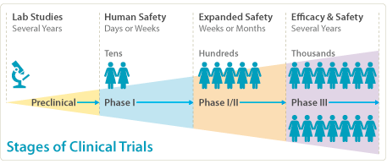
(b) Contra el argumento paternalista
  El paternalismo tiene consecuencias perversas
    └ Sacrificamos la salud de los pacientes que podrían beneficiarse de un medicamento ahora por la seguridad de los pacientes futuros.
Notes:
As of today, the FDA and the EMA are endorsing a Hard form of pharmaceutical parternalism: basically, they are preventing patients without their consent to take non-approved drugs, for the sake of their own health.

Slide 49
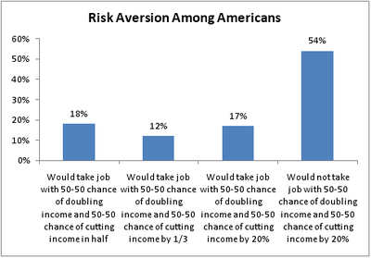
(b) Contra el argumento paternalista
  El paternalismo se basa en la aversión al riesgo
    └ No todo el mundo lo es igualmente en todas las circunstancias
Notes:
As of today, the FDA and the EMA are endorsing a Hard form of pharmaceutical parternalism: basically, they are preventing patients without their consent to take non-approved drugs, for the sake of their own health.

Slide 50
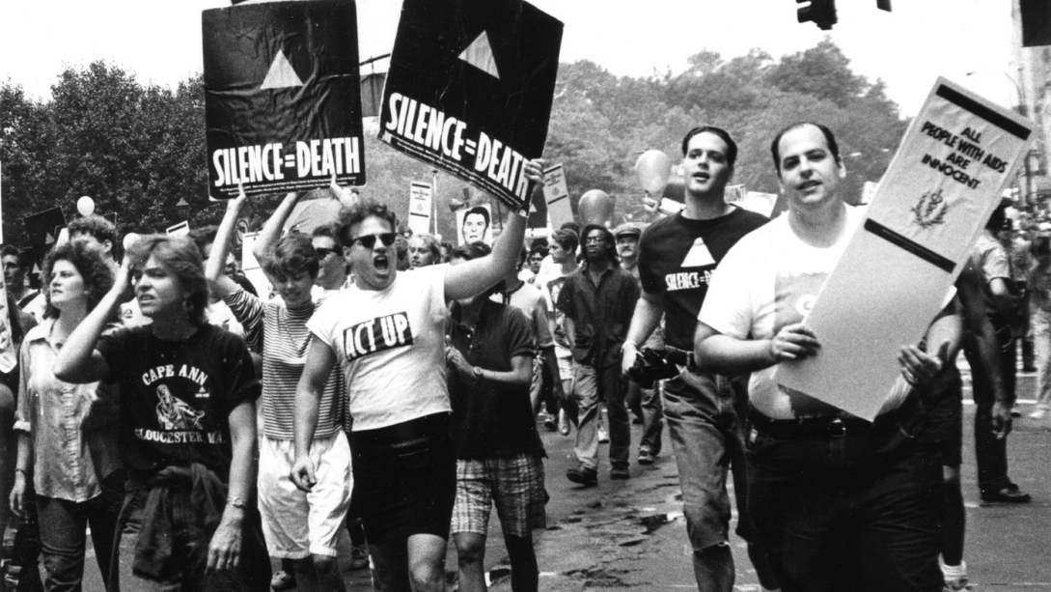
(b) La relajación del paternalismo
  1987: Los ensayos del AZT
    └ FDA: Acceso adelantado, acortando los ensayos clínicos
Notes:
As of today, the FDA and the EMA are endorsing a Hard form of pharmaceutical parternalism: basically, they are preventing patients without their consent to take non-approved drugs, for the sake of their own health.

Slide 51
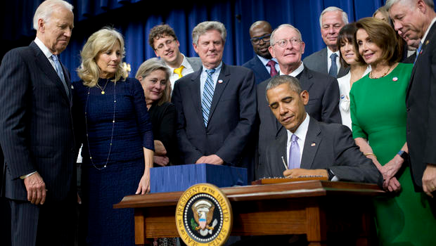
  President Barack Obama signs the 21st Century Cures Act, on Dec. 13, 2016, in the South Court Auditorium in the Eisenhower Executive Office Building on the White House complex in Washington. Standing behind, from left are, Vice President Joe Biden, his wife Jill Biden, Rep. Frank Pallone, D-N.J., Sen. Lamar Alexander, R-Tenn., House Minority Leader Nancy Pelosi of Calif., and Rep. Fred Upton, R-Mich.(AP Photo/Pablo Martinez Monsivais)
Notes:
I am going to talk today about the 21st Century Cures Act, signed last december by President Obama. This is a huge bill (almost a 1000 pages long) aiming at restructuring the funding, regulation and delivery of biomedical research

Slide 52
The 21st Century Cures Act
Subtitle D: Modern Trial Design and Evidence Development
  (Sec. 2061) The FDA must issue guidance that addresses using alternative statistical methods in clinical trials and in the development and review of drugs.
  (Sec. 2062) To support approval of a drug for a new indication, the FDA must evaluate the use of evidence from clinical experience (in place of evidence from clinical trials) and establish a streamlined data review program
Notes:
And in this context we should return to the 21st Century Cures Act, that does not openly contest paternalism, but challenges it implicitly by making way to new standards for drug testing. This is in Subtitle D, where it calls for alternative statistical methods and clinical experience

Slide 53
  “[T]he 21st Century Cures Act could substantially lower the standards for approval of many medical products, potentially placing patients at unnecessary risk of injury or death. While the legislation does not mandate this approach, it opens the door to it.
Notes:
Including here some of the gay activists who paved the way to the relaxation of paternalims with the revolt against the AZT trials. And it’s tricky, because once you decide to relax paternalism, how much is enough?

Slide 54
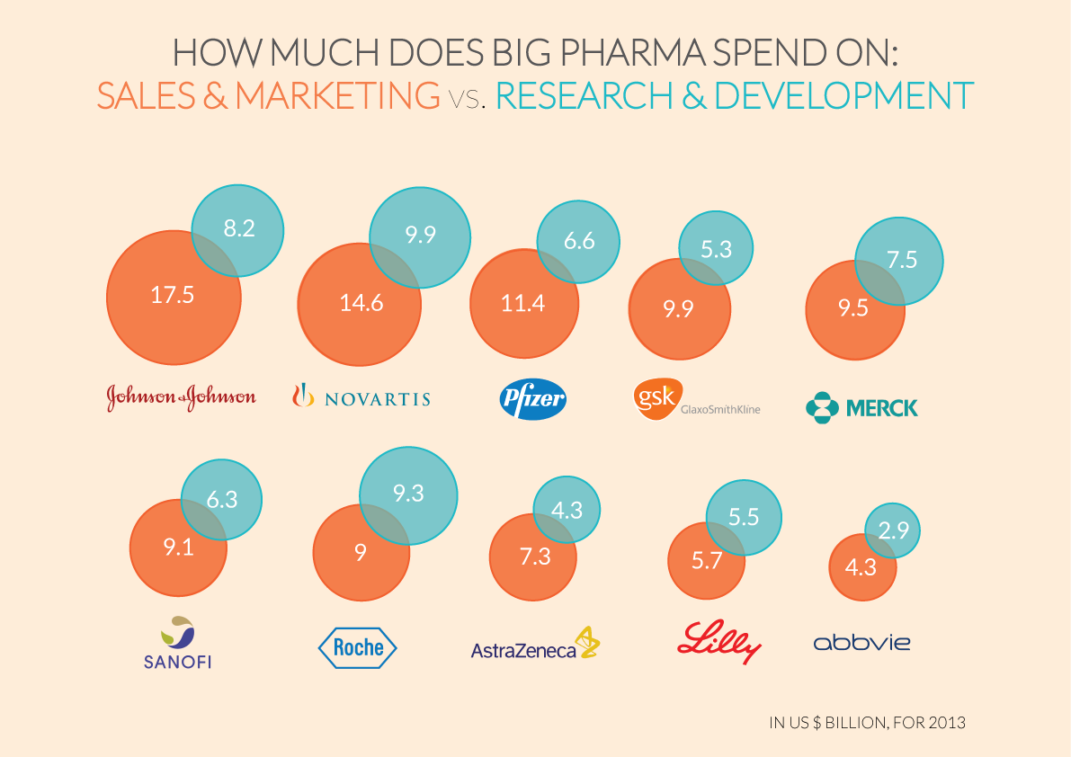

Slide 55
¿Cuánto relajar el paternalismo farmacéutico?
  La FDA 1962 Act implementa un paternalismo farmacéutico fuerte
  Este paternalismo se basa en la aversión al riesgo de los consumidores, y se traduce en un criterio riguroso de prueba (ensayos clínicos)
  Este paternalismo tiene efectos perversos | La aversión al riesgo no es uniforme
  Relajando los criterios de prueba se relaja el paternalismo. Pero ¿cuánto es demasiado?
Notes:
As of today, the FDA and the EMA are endorsing a Hard form of pharmaceutical parternalism: basically, they are preventing patients without their consent to take non-approved drugs, for the sake of their own health.

Slide 56
Un nuevo argumento a favor del paternalismo
  Un paciente podrá asumir riesgos siempre que la incertidumbre sobre un medicamento sea auténtica.
  Sin embargo, tenemos razones para desconfiar de las estimaciones de riesgo que nos proporciona la industria farmacéutica
Notes:
As of today, the FDA and the EMA are endorsing a Hard form of pharmaceutical parternalism: basically, they are preventing patients without their consent to take non-approved drugs, for the sake of their own health.

Slide 57
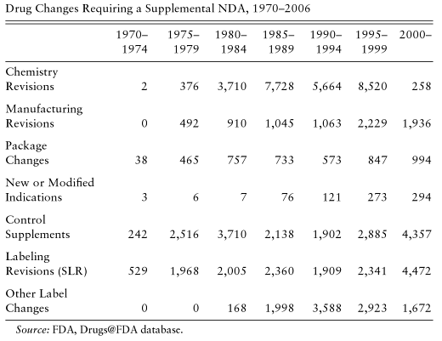
  La incertidumbre en cifras (1)
Notes:
How big is it? Well, we can judge it by the number of side effects that weren’t detected in the trial, and in the period between 1970 and 2006, there were minor revisions in almost 3 out of four drugs approved by the American pharmaceutical agency, the FDA. That’s a lot of uncertainty.

Slide 58
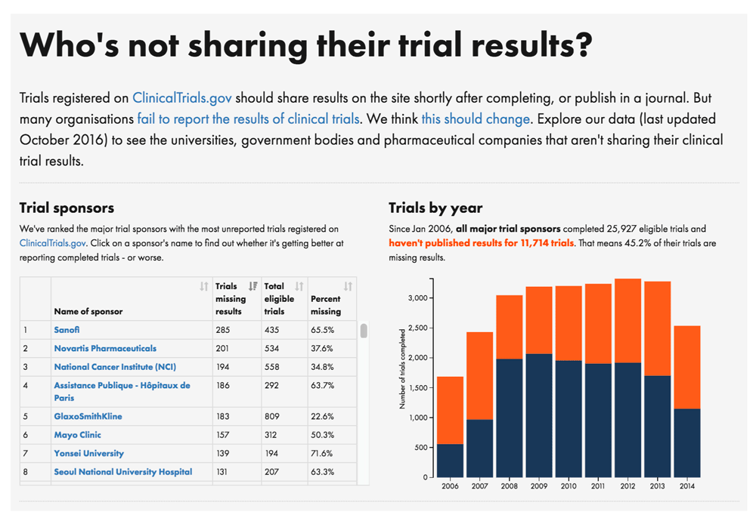
  La incertidumbre en cifras (2)
Notes:
How big is it? Well, we can judge it by the number of side effects that weren’t detected in the trial, and in the period between 1970 and 2006, there were minor revisions in almost 3 out of four drugs approved by the American pharmaceutical agency, the FDA. That’s a lot of uncertainty.

Slide 59
Un nuevo argumento a favor del paternalismo
  Un paciente podrá asumir riesgos siempre que la incertidumbre sobre un medicamento sea auténtica.
  Sin embargo, tenemos razones para desconfiar de las estimaciones de riesgo que nos proporciona la industria farmacéutica.
  Tenemos razones para desconfiar del juicio de los médicos (sometidos a la presión comercial de la industria): 10.000$ x médico (2007)
Notes:
As of today, the FDA and the EMA are endorsing a Hard form of pharmaceutical parternalism: basically, they are preventing patients without their consent to take non-approved drugs, for the sake of their own health.

Slide 60
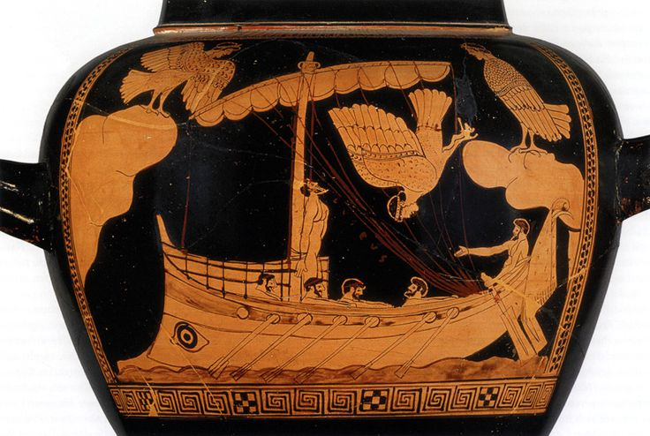
Un nuevo argumento a favor del paternalismo
  El contrato de Ulises:
  Es racional para el paciente delegar en una institución imparcial la estimación de los riesgos, privándole de acceso al medicamento si es necesario.
Notes:
As of today, the FDA and the EMA are endorsing a Hard form of pharmaceutical parternalism: basically, they are preventing patients without their consent to take non-approved drugs, for the sake of their own health.

Slide 61
Un nuevo argumento a favor del paternalismo
  Un paciente podrá asumir riesgos siempre que la incertidumbre sobre un medicamento sea auténtica.
  Sin embargo, tenemos razones para desconfiar de las estimaciones de riesgo que nos proporciona la industria farmacéutica
    Es racional para el paciente delegar en un regulador farmacéutico paternalista
Notes:
As of today, the FDA and the EMA are endorsing a Hard form of pharmaceutical parternalism: basically, they are preventing patients without their consent to take non-approved drugs, for the sake of their own health.

Slide 62
Dos objeciones
  La objeción socialista:
  El problema es el mercado
  2) La objeción libertaria
  La solución es el mercado
Notes:
As of today, the FDA and the EMA are endorsing a Hard form of pharmaceutical parternalism: basically, they are preventing patients without their consent to take non-approved drugs, for the sake of their own health.

Slide 63
La objeción socialista
  La objeción socialista:
    Es racional para el paciente delegar en una institución imparcial la estimación de los riesgos, privándole de acceso al medicamento si es necesario.
    └ No hay instituciones cuya imparcialidad pueda resistir la presión de la industria farmacéutica
Notes:
As of today, the FDA and the EMA are endorsing a Hard form of pharmaceutical parternalism: basically, they are preventing patients without their consent to take non-approved drugs, for the sake of their own health.

Slide 64
La objeción socialista
  Peter C. Gøtzsche
    La impotencia de la FDA
    70% de sus científicos no cree que los productos que aprueban sean seguros
    51% registran cambias en el prospecto por problemas de seguridad
    20% reciben avisos de peligrosidad
    1 de cada 20 se retira del mercado
Notes:
As of today, the FDA and the EMA are endorsing a Hard form of pharmaceutical parternalism: basically, they are preventing patients without their consent to take non-approved drugs, for the sake of their own health.

Slide 65
La objeción socialista
  Peter C. Gøtzsche
    ¿Qué hacer?
    Una industria farmacéutica pública con incentivos en forma de premios a la investigación (no patentes)
    Ensayos clínicos públicos, con datos públicos
    Criterios de aprobación más duros
    Fin de la publicidad farmacéutica
Notes:
As of today, the FDA and the EMA are endorsing a Hard form of pharmaceutical parternalism: basically, they are preventing patients without their consent to take non-approved drugs, for the sake of their own health.

Slide 66
La objeción socialista
  Peter C. Gøtzsche
    ¿Qué hacer?
    Una industria farmacéutica pública con incentivos en forma de premios a la investigación (no patentes)
    Ensayos clínicos públicos, con datos públicos
    Criterios de aprobación más duros
    Fin de la publicidad farmacéutica
Notes:
As of today, the FDA and the EMA are endorsing a Hard form of pharmaceutical parternalism: basically, they are preventing patients without their consent to take non-approved drugs, for the sake of their own health.

Slide 67
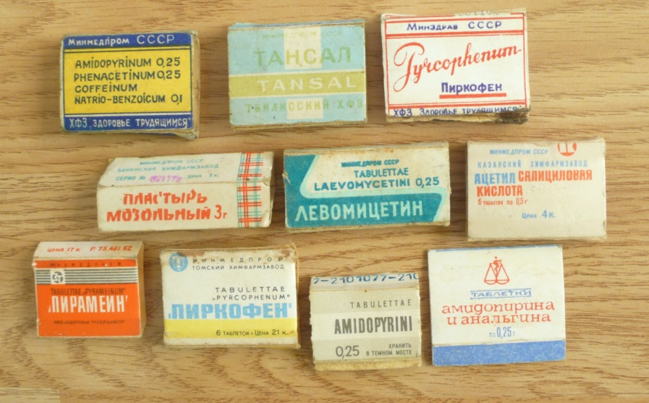
Mi réplica
    ¿Podemos prescindir del mercado?
    El fracaso farmacéutico de la URSS:
    1 patente en 75 años
Notes:
As of today, the FDA and the EMA are endorsing a Hard form of pharmaceutical parternalism: basically, they are preventing patients without their consent to take non-approved drugs, for the sake of their own health.

Slide 68

Mi réplica
    ¿Es el mercado o el monopolio?
    ¿Por qué las farmacéuticas invierten más en publicidad que en investigación?
Notes:
As of today, the FDA and the EMA are endorsing a Hard form of pharmaceutical parternalism: basically, they are preventing patients without their consent to take non-approved drugs, for the sake of their own health.

Slide 69
La objeción libertaria
  La objeción libertaria:
    Es racional para el paciente delegar en una institución imparcial la estimación de los riesgos, privándole de acceso al medicamento si es necesario.
    └ La libre competencia es más efectiva que la regulación, también en farmacología
Notes:
As of today, the FDA and the EMA are endorsing a Hard form of pharmaceutical parternalism: basically, they are preventing patients without their consent to take non-approved drugs, for the sake of their own health.

Slide 70
La objeción libertaria
  Julian Reiss
    Hay distintos métodos para estimar los riesgos: ¿por qué privilegiar uno?
    Incrementar la competencia es el mejor estímulo para que la industria acierte
    El sistema judicial proporciona la mejor defensa para el consumidor, si se equivoca
Notes:
As of today, the FDA and the EMA are endorsing a Hard form of pharmaceutical parternalism: basically, they are preventing patients without their consent to take non-approved drugs, for the sake of their own health.

Slide 71
Mi réplica
  ¿Cómo ha de decidir el juez, en caso de litigio?
    Un “estado de naturaleza” farmacéutico
    ¿Es más fácil manipular a una institución, a un científico, a un médico?
Notes:
As of today, the FDA and the EMA are endorsing a Hard form of pharmaceutical parternalism: basically, they are preventing patients without their consent to take non-approved drugs, for the sake of their own health.

Slide 72
  ¿Por qué el Estado nos impide tomar los medicamentos que queremos?
  Para proteger el mercado farmacéutico
  (Argumento liberal contra la selección adversa)
  b) Para proteger a los consumidores contra la explotación farmacéutica de la incertidumbre
    (Un contrato de Ulises paternalista)
Notes:
As of today, the FDA and the EMA are endorsing a Hard form of pharmaceutical parternalism: basically, they are preventing patients without their consent to take non-approved drugs, for the sake of their own health.

